Slide 1
Classes, Prototypes And Modules

Slide 2
Contents
Factory Function
Constructor Function
Prototypes
Prototype inheritance
Class
Super()
Modules

Slide 3
Factory Function
function factoryFunction(name, section){
return {
name,
section
}
}
let object1 = factoryFunction("raju", "A");
let object2 = factoryFunction("ramu", "B");
console.log(object1, object2);
//{ name: 'raju', section: 'A' } { name: 'ramu', section: 'B' }

Slide 4
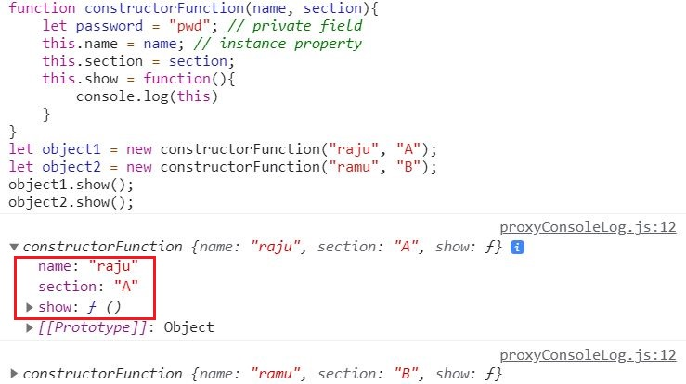
Constructor Function

Slide 5
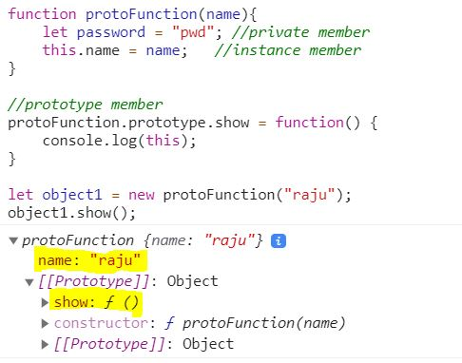
Prototypes

Slide 6
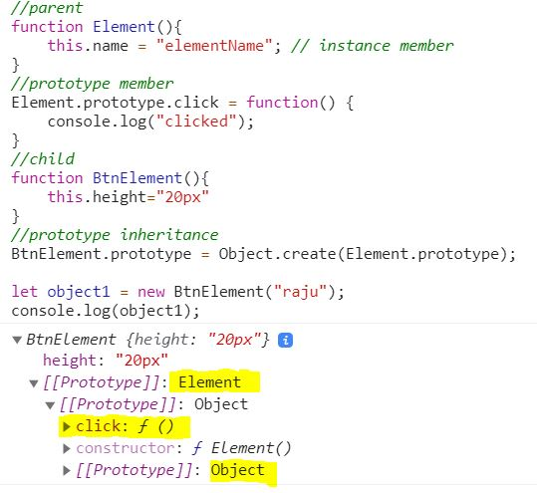
Prototype Inheritance

Slide 7
Class
Classes are one of the features introduced in the ES6 version of JavaScript.
JavaScript Classes are templates for JavaScript Objects.
In JavaScript, a class is a kind of function.
https://medium.com/@parsyval/javascript-prototype-vs-class-a7015d5473b

Slide 8
Super()
The super keyword refers to the parent class.
It is used to call the constructor of the parent class and to access the parent's properties and methods.
class Car {
constructor(brand) { this.carname = brand; }
}
class Model extends Car {
constructor(brand, mod) {
super(brand);
this.model = mod;
console.log(this.carname, this.model) //Ford Mustang
}
}
mycar = new Model("Ford", "Mustang");

Slide 9
Modules
As our application grows bigger, we want to split it into multiple files, so called “modules”. A module may contain a class or a library of functions for a specific purpose.
Previously used module system,
AMD, CommonJS (NodeJS), UMD
After ES6 Native module system is introduced.
<script type="module"> tell the browser that a script should be treated as a module.
export keyword labels variables and functions that should be accessible from outside the current module.
import allows the import of functionality from other modules.

Slide 10
Demo
// 📁 sayHi.js
export function sayHi(user) {
alert(`Hello, ${user}!`);
}
// 📁 main.js
import {sayHi} from './sayHi.js';
alert(sayHi); // function...
sayHi('John'); // Hello, John!

Slide 11
Export default
// 📁 user.js
export default class User { // just add "default"
constructor(name) {
this.name = name;
}
}
// 📁 main.js
import User from './user.js'; // not {User}, just User
new User('John');

Slide 12
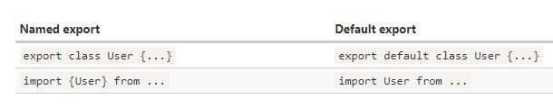
Difference
Also named export may have no name.
export default function(user) { // no function name
alert(`Hello, ${user}!`);
}
export default ['Jan', 'Feb', 'Mar’] // no variable name

